Slide 1
Quantization
CS XXX: Introduction to Large Language Models

Slide 2
Contents
Attention Intuition
Actual Self-Attention
MultiHead Self-Attention
Transformer
Positional Embeddings
Language Modeling with Transformer

Slide 3
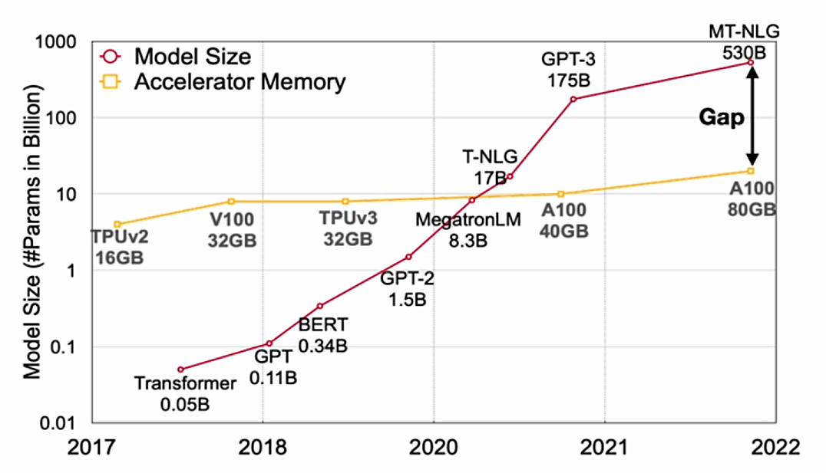

How to make models accessible?
In 2023 – 2024 the largest most used models seem to be around $\sim$70B parameters

Slide 4
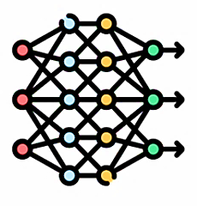
How to make models accessible?
Model Compression
Original Model
Smaller Model

Slide 5
How to make models accessible?
Quantization is one method to perform model compression.
Model Compression
Original Model
Smaller Model

Slide 6
















How to make models accessible?
Neural Network: A series of weights and activations
$$h_{θ}\left(x\right)={σ_{2}(W}_{2}({σ_{1}(W}_{1}x)))$$
Input Layer
Hidden Layer
Output Layer
$$W_{1}$$
$$a_{1}^{(1)}$$
$$y_{1}^{(1)}$$
$$W_{2}$$
$$x_{1}$$
$$a_{2}^{(1)}$$
$$y_{2}^{(1)}$$
$$x_{2}$$
$$y_{1}^{(2)}$$
$$y_{3}^{(1)}$$
$$h_{θ}(x)$$
$$a_{3}^{(1)}$$
$$x_{3}$$
Weights
$$y_{4}^{(1)}$$
$$a_{4}^{(1)}$$
Activation

Slide 7
















How to make models accessible?
Neural Network: A series of weights and activations
$h_{θ}\left(x\right)={σ_{2}(W}_{2}({σ_{1}(W}_{1}x)))$
Input Layer
Hidden Layer
Output Layer
$$W_{1}$$
$$a_{1}^{(1)}$$
$$y_{1}^{(1)}$$
$$W_{2}$$
$$x_{1}$$
$$a_{2}^{(1)}$$
$$y_{2}^{(1)}$$
$$x_{2}$$
$$y_{1}^{(2)}$$
$$h_{θ}(x)$$
We can quantize both weights and activations
$$y_{3}^{(1)}$$
$$a_{3}^{(1)}$$
$$x_{3}$$
$$y_{4}^{(1)}$$
$$a_{4}^{(1)}$$

Slide 8
How to make models accessible?
Quantization: store the parameters of the model in lower precision
13.5 | 14.3 | 8.5
-4.7 | -3.2 | -6.4
-0.4 | 1.3 | 3.73
FP32 to INT8
13 | 14 | 8
-5 | -3 | -6
0 | 1 | 4
FP32: 4 bytes to store each value
INT8: 1 byte to store each value
Total: 36 bytes
Total: 9 bytes

Slide 9


How to make models accessible?
A quantized tensor can be converted back to its approximate original form through de-quantization. However, this process introduces a discrepancy between the de-quantized tensor and the original tensor, known as the quantization error.
13.5 | 14.3 | 8.5
-4.7 | -3.2 | -6.4
-0.4 | 1.3 | 3.73
13 | 14 | 8
-5 | -3 | -6
0 | 1 | 4
14.0 | 14.6 | 9.0
-5.0 | -3.4 | -6.8
-0.8 | 1.6 | 3.96
FP32 to INT8
de-quantize
14.0 | 14.6 | 9.0
-5.0 | -3.4 | -6.8
-0.8 | 1.6 | 3.96
13.5 | 14.3 | 8.5
-4.7 | -3.2 | -6.4
-0.4 | 1.3 | 3.73
0.5 | 0.3 | 0.5
-0.3 | -0.2 | -0.4
-0.4 | 0.3 | 0.23
$$−$$
$$=$$
Quantization Error

Slide 10

Data Types and Sizes
Signed and Unsigned INT
Unsigned INT
Range for n-bits: $[{0,2}^{n}−1]$
8 bit example (torch.uint8): $[0,255]$
$\left(1×2^{7}\right)+\left(1×2^{3}\right)+\left(1×2^{0}\right)=137$
1 | 0 | 0 | 0 | 1 | 0 | 0 | 1
$$2^{7}$$ | $$2^{6}$$ | $$2^{5}$$ | $$2^{4}$$ | $$2^{3}$$ | $$2^{2}$$ | $$2^{1}$$ | $$2^{0}$$

Slide 11

Data Types and Sizes
Signed and Unsigned INT
Signed INT
Range for n-bits: $[{−2^{n−1},2}^{n−1}−1]$
8 bit example (torch.uint8): $[−128,127]$
$\left(1×{−2}^{7}\right)+\left(1×2^{3}\right)+\left(1×2^{0}\right)=−119$
1 | 0 | 0 | 0 | 1 | 0 | 0 | 1
$${−2}^{7}$$ | $$2^{6}$$ | $$2^{5}$$ | $$2^{4}$$ | $$2^{3}$$ | $$2^{2}$$ | $$2^{1}$$ | $$2^{0}$$

Slide 12
Data Types and Sizes
Pytorch data types
Data Type | torch.dtype
8-bit signed integer | torch.int8
8-bit unsigned integer | torch.uint8
16-bit signed integer | torch.int16
32-bit signed integer | torch.int32
64-bit signed integer | torch.int64

Slide 13
Data Types and Sizes
torch.iinfo()
0 | torch.iinfo(torch.uint8)
iinfo(min=0, max=255, dtype=uint8)
0 | torch.iinfo(torch.int8)
iinfo(min=-128, max=127, dtype=int8)

Slide 14
Data Types and Sizes
3 components in floating point:
Sign: positive/negative (always 1 bit)
Exponent (range): impact the representable range of the number
Fraction (precision): impact on the precision of the number
FP32, BF16, FP16, FP8 are floating point format with a specific number of bits for exponent and the fraction.

Slide 15
Data Types and Sizes
FP32
Sign: 1 bit
Exponent (range): 8 bit
Fraction (precision): 23 bit
Total 32bit
FP16
Sign: 1 bit
Exponent (range): 5 bit
Fraction (precision): 10 bit
Total: 16 bit

Slide 16
Data Types and Sizes
BF16
Sign: 1 bit
Exponent (range): 8 bit
Fraction (precision): 7 bit
Total: 16 bit

Slide 17
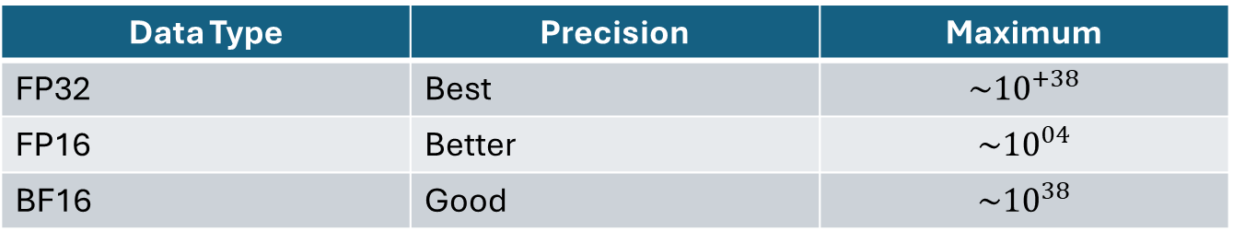
Data Types and Sizes
Floating point data types
Data Type | Precision | Maximum
FP32 | Best | $$\sim {10}^{+38}$$
FP16 | Better | $$\sim {10}^{04}$$
BF16 | Good | $$\sim {10}^{38}$$

Slide 18
Data Types and Sizes
Pytorch floating point data types
Data Type | torch.dtype
16-bit floating point | torch.float16
16-bit brain floating point | torch.bfloat16
32-bit floating point | torch.float32
64-bit floating point | torch.float64

Slide 19
Data Types and Sizes
Pytorch floating point data types
0 1 | value = 1/3 format(value,'.60f')
0.333333333333333314829616256247390992939472198486328125000000
0 1 | tensor_fp64 = torch.tensor(value, dtype=torch.float64) print(format(tensor_fp64.item(),'.60f'))
0.333333333333333314829616256247390992939472198486328125000000
0 1 | tensor_fp32 = torch.tensor(value, dtype=torch.float32) print(format(tensor_fp32.item(),'.60f'))
0.333333343267440795898437500000000000000000000000000000000000

Slide 20
Data Types and Sizes
When a higher data type tensor is downcast to a lower data type there is loss of data.
0 1 | tensor_fp32 = torch.rand(1000,dtype=torch.float32) tensor_fp32[:5]
tensor([0.3550, 0.0233, 0.4281, 0.1533, 0.8589])
0 1 | tensor_fp32_to_bf16 = tensor_fp32.to(dtype=torch.bfloat16) tensor_fp32_to_bf16[:5]
tensor([0.3555, 0.0232, 0.4277, 0.1533, 0.8594], dtype=torch.bfloat16)

Slide 21
Loading models by data type
0 1 | from transformers import AutoTokenizer, AutoModelForCausalLM tokenizer = AutoTokenizer.from_pretrained("bigscience/bloom-560m")
0 1 | model_fp32 = AutoModelForCausalLM.from_pretrained("bigscience/bloom-560m", torch_dtype = torch.float32) print("Memory footprint in MBs", model_fp32.get_memory_footprint()/1e+6)
Memory footprint in MBs 2236.858368
0 1 | model_bf16 = AutoModelForCausalLM.from_pretrained("bigscience/bloom-560m", torch_dtype = torch.bfloat16) print("footprint in MBs", model_bf16.get_memory_footprint()/1e+6)
Memory footprint in MBs 1118.429184

Slide 22
Loading models by data type
Loading models in lower data types will affect performance
0 1 2 | from transformers import AutoTokenizer, AutoModelForCausalLM, pipeline tokenizer = AutoTokenizer.from_pretrained("bigscience/bloom-560m") input_text = "Artificial intelligence is"

Slide 23
Loading models by data type
Loading models in lower data types will affect performance
0 1 2 | model_fp32 = AutoModelForCausalLM.from_pretrained("bigscience/bloom-560m", torch_dtype = torch.float32) generator = pipeline("text-generation", model=model_fp32, tokenizer = tokenizer) output = generator(input_text, max_length=20) print(output[0][‘generated_text’])
Artificial intelligence is a new field of research that has been gaining attention in recent years.
0 1 2 3 | model_bf16 = AutoModelForCausalLM.from_pretrained("bigscience/bloom-560m", torch_dtype = torch.bfloat16) generator = pipeline("text-generation", model=model_fp32, tokenizer = tokenizer) output = generator(input_text, max_length=20) print(output[0][‘generated_text’])
Artificial intelligence is a new field in the field of artificial intelligence, which is a new type of artificial intelligence.

Slide 24
Quantization
Quantization refers to the process of mapping a large set to a smaller set of values
-234.1
FP32
251.51
-128
INT8
127

Slide 25
Quantization
8-bit linear quantization
We fill the rest of the values following a linear mapping
We map the extreme values together
191.6 | -13.5 | 728.6
92.14 | 295.5 | -184
0 | 684.6 | 245.5
 |  | 127
 |  | -128
191.6 | -13.5 | 728.6
92.14 | 295.5 | -184
0 | 684.6 | 245.5
 | -81 | 127
 |  | -128
 | 114
Original tensor in FP32
Quantized tensor in INT8
(between -128 and 127)
Original tensor in FP32
Quantized tensor in INT8
(between -128 and 127)
191.6 | -13.5 | 728.6
92.14 | 295.5 | -184
0 | 684.6 | 245.5
-23 | -81 | 127
-51 | 6 | -128
-77 | 114 | -8
Original tensor in FP32
Quantized tensor in INT8

Slide 26
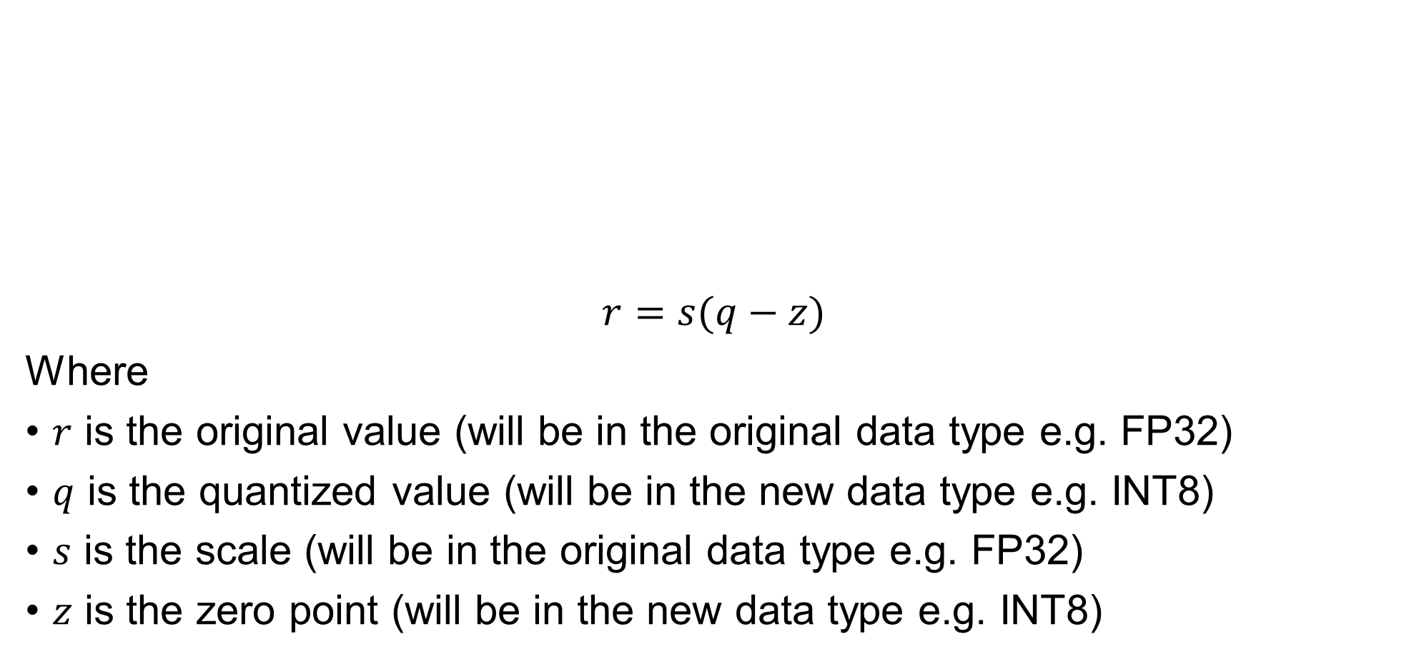
Linear Quantization
$$r=s(q−z)$$
Where
$r$ is the original value (will be in the original data type e.g. FP32)
$q$ is the quantized value (will be in the new data type e.g. INT8)
$s$ is the scale (will be in the original data type e.g. FP32)
$z$ is the zero point (will be in the new data type e.g. INT8)
r_min
0
r_max
q_min
z
q_max

Slide 27

Linear Quantization
Linear Quantization
$$r=s(q−z)$$
$$q=\frac{r}{s}+z$$
For INT:
$$q=\text{int}\left(\text{round}\left(\frac{r}{s}+z\right)\right)$$

Slide 28

Linear Quantization
Linear quantization
$$q=\text{int}\left(\text{round}\left(\frac{r}{s}+z\right)\right)$$
0 1 2 3 4 5 6 7 8 9 | def linear_quantization(r, scale, zero_point, dtype=torch.int8): #Map to min and max of new data type q_min = torch.iinfo(dtype).min q_max = torch.iinfo(dtype).max #q = int(round(r/(s+z))) #rounded_tensor = torch.round(r/scale+zero_point) rounded_tensor = torch.round((r/scale) + zero_point) q = rounded_tensor.clamp(q_min, q_max).to(dtype) return q

Slide 29
Linear Quantization
Linear quantization
0 1 2 3 4 5 6 7 8 9 10 11 12 | r = torch.tensor( [ [191.6, -13.5, 728.6], [92.14, 295.5, -184], [0, 684.6, 245.5] ] ) scale = 3.5 zero_point = -70 q = linear_quantization(r,scale, zero_point) print(q)
tensor([[ -15, -74, 127], [ -44, 14, -123], [ -70, 126, 0]], dtype=torch.int8)

Slide 30
Linear Quantization
de-quantization
Dequantize the quantized tensor
0 1 2 | def linear_dequantization(q, scale, zero_point): #r=s(q-z) return scale * (q.float()-zero_point)
0 1 | deq_r = linear_dequantization(q, scale, zero_point) print(deq_r)
tensor([[ 193.2565, -14.3153, 730.0800], [ 93.0494, 297.0423, -182.5200], [ 0.0000, 683.5552, 246.9388]])

Slide 31
Linear Quantization
Calculate an overall quantization error using “mean squared error” technique
0 1 2 3 4 5 | error = (deq_r - r) print(error) error_squared = error.square() print(error_squared) mean_squared_error = error_squared.mean() #(deq_r - r).square.mean() print(mean_squared_error)
tensor([[ 1.6564, -0.8153, 1.4800], [ 0.9094, 1.5423, 1.4800], [ 0.0000, -1.0447, 1.4388]]) tensor([[2.7438, 0.6647, 2.1903], [0.8270, 2.3788, 2.1904], [0.0000, 1.0915, 2.0702]]) tensor(1.5730)

Slide 32

Linear Quantization
There are two modes in linear quantization
Asymmetric: we map $[r_{\text{min}}, { r}_{\text{max}}]$ to $[q_{\text{min}}, q_{\text{max}}]$
Symmetric: we map $[{−r}_{\text{max}}, { r}_{\text{max}}]$ to $[{−q}_{\text{max}}, q_{\text{max}}]$
Where we set $r_{\text{max}}=\text{max}\left(\left|r\right|\right),$ $r$ is the original tensor
r_min
0
r_max
q_min
z
q_max
-r_max
0
r_max
Symmetric with respect to 0
-q_max
z
q_max

Slide 33

Asymmetric Linear Quantization
Asymmetric linear quantization maps $[r_{\text{min}}, { r}_{\text{max}}]$ to $[q_{\text{min}}, q_{\text{max}}]$
$$s=\frac{r_{\text{max}}−r_{\text{min}}}{q_{\text{max}}−q_{\text{min}}}$$
$$z=\frac{q_{\text{min}}−r_{\text{min}}}{s}$$
For INT:
$$z=\text{int}\left(\text{round}\left(\frac{q_{\text{min}}−r_{\text{min}}}{s}\right)\right)$$

Slide 34

Asymmetric Linear Quantization
Zero point out of range
Case 1 ($z<q_{\text{min}}$): we set $z=q_{\text{min}}$
Case 2 ($z>q_{\text{min}}$): we set $z=q_{\text{max}}$
r_min
0
r_max
z
q_min
q_max
r_min
0
r_max
q_min
q_max
z

Slide 35
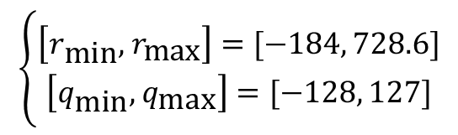

Asymmetric Linear Quantization
Scale and Zero point
$$s=\frac{728.6−\left(−184\right)}{127−(−128)}=3.58$$
$$z=\text{int}\left(\text{round}\left(\frac{−128−(−184)}{3.58}\right)\right)=−77$$
191.6 | -13.5 | 728.6
92.14 | 295.5 | -184
0 | 684.6 | 245.5
$$\left\{\begin{aligned}\left[r_{\text{min}}, { r}_{\text{max}}\right]=[−184, 728.6] \\ \left[q_{\text{min}}, { q}_{\text{max}}\right]=[−128, 127]\end{aligned}\right.$$

Slide 36
Asymmetric Linear Quantization
Scale and Zero point
0 1 2 3 4 5 6 7 8 9 10 11 12 13 14 15 16 17 18 19 | def linear_asymmetric_quantization_scale_and_zero_point(r, dtype=torch.int8): q_min = torch.iinfo(dtype).min q_max = torch.iinfo(dtype).max #scale = ((r_max - r_min)/(q_max - q_min)) r_max = r.max().item() r_min = r.min().item() scale = (r_max - r_min)/(q_max - q_min) #zero_point = int(round(q_min - (r_min/scale))) zero_point = q_min - (r_min/scale) #clip the zero point to fall in [q_min, q_max] if zero_point < q_min: zero_point = q_min elif zero_point > q_max: zero_point = q_max else: zero_point = int(round(zero_point)) return scale, zero_point

Slide 37
Asymmetric Linear Quantization
0 1 2 3 4 5 6 7 8 9 10 11 | r = torch.tensor( [ [191.6, -13.5, 728.6], [92.14, 295.5, -184], [0, 684.6, 245.5] ] ) scale, zero_point = linear_asymmetric_quantization_scale_and_zero_point(r) print("scale:", scale, "zero_point:", zero_point) q = linear_quantization(r,scale, zero_point) print(q)
scale: 3.578823433670343 zero_point: -77 tensor([[ -23, -81, 127], [ -51, 6, -128], [ -77, 114, -8]], dtype=torch.int8)

Slide 38
Asymmetric Linear Quantization
Quantization Error
0 1 2 3 | deq_r = linear_dequantization(q, scale, zero_point) print(deq_r) mean_squared_error = (deq_r - r).square().mean() print(mean_squared_error)
tensor([[ 193.2565, -14.3153, 730.0800], [ 93.0494, 297.0423, -182.5200], [ 0.0000, 683.5552, 246.9388]]) tensor(1.5730)

Slide 39
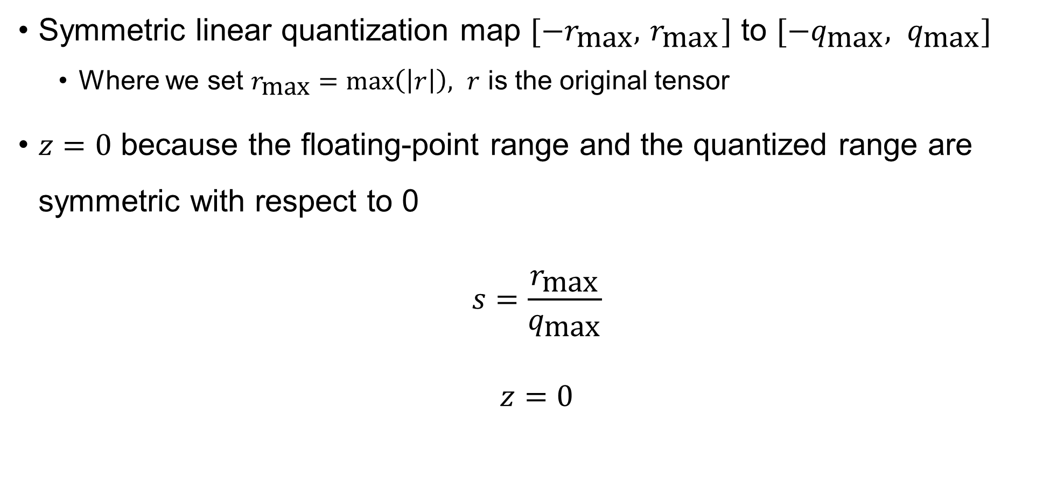
Symmetric Linear Quantization
Symmetric linear quantization map $[{−r}_{\text{max}}, { r}_{\text{max}}]$ to $[{−q}_{\text{max}}, q_{\text{max}}]$
Where we set $r_{\text{max}}=\text{max}\left(\left|r\right|\right),$ $r$ is the original tensor
$z=0$ because the floating-point range and the quantized range are symmetric with respect to 0
$$s=\frac{r_{\text{max}}}{q_{\text{max}}}$$
$$z=0$$

Slide 40
Symmetric Linear Quantization
Scale and Zero point
0 1 2 3 4 5 6 7 8 9 10 | def linear_symmetric_quantization_scale_and_zero_point(r, dtype=torch.int8): q_max = torch.iinfo(dtype).max #scale = r_max/q_max r_max = r.abs().max().item() scale = r_max/q_max #zero_point = 0 zero_point = 0 return scale, zero_point

Slide 41
Symmetric Linear Quantization
0 1 2 3 4 5 6 7 8 9 10 11 | r = torch.tensor( [ [191.6, -13.5, 728.6], [92.14, 295.5, -184], [0, 684.6, 245.5] ] ) scale, zero_point = linear_symmetric_quantization_scale_and_zero_point(r) print("scale:", scale, "zero_point:", zero_point) q = linear_quantization(r,scale, zero_point) print(q)
scale: 5.737007681779035 zero_point: 0 tensor([[ 33, -2, 127], [ 16, 52, -32], [ 0, 119, 43]], dtype=torch.int8)

Slide 42
Symmetric Linear Quantization
Quantization Error
0 1 2 3 | deq_r = linear_dequantization(q, scale, zero_point) print(deq_r) mean_squared_error = (deq_r - r).square().mean() print(mean_squared_error)
tensor([[ 189.3213, -11.4740, 728.6000], [ 91.7921, 298.3244, -183.5842], [ 0.0000, 682.7039, 246.6913]]) tensor(2.5092)

Slide 43
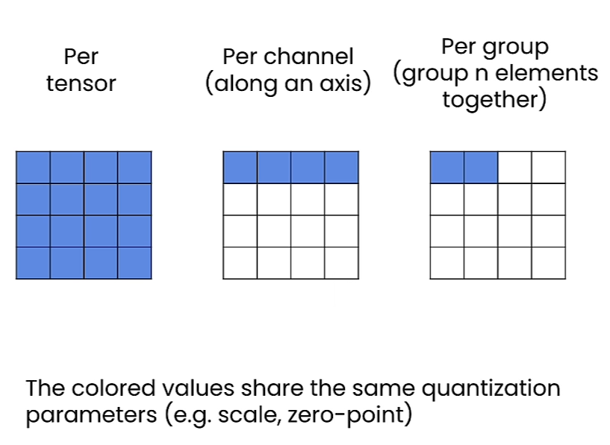
Changing Granularity
Granularity: The more granular the quantization is the more accurate it will be

Slide 44
Per Tensor
Per Tensor symmetric quantization (same as before)
0 1 2 3 4 5 6 7 8 9 10 11 12 | r = torch.tensor( [ [191.6, -13.5, 728.6], [92.14, 295.5, -184], [0, 684.6, 245.5] ] ) scale, zero_point = linear_symmetric_quantization_scale_and_zero_point(r) q = linear_quantization(r,scale, zero_point) print(q) deq_r = linear_dequantization(q, scale, zero_point) mean_squared_error = (deq_r - r).square().mean() print(mean_squared_error)
tensor([[ 33, -2, 127], [ 16, 52, -32], [ 0, 119, 43]], dtype=torch.int8) tensor(2.5092)

Slide 45
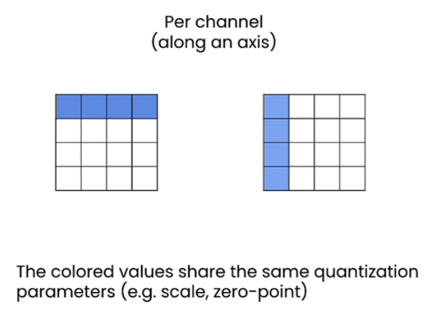
Per Channel
Need to store quantization params for each row or column depending on which axis we choose to quantize along

Slide 46
Per Channel
0 1 2 3 4 5 6 7 8 9 10 11 12 13 14 15 16 17 18 19 20 | def per_channel_quantization_scale_and_zero_point(r, d, dtype=torch.int8): dim = d #dim = 0 to quantize along rows, dim = 1 to quantize along the columns #dimension of scale_tensor and zero_point_tensor scale_tensor_dim = r.shape[dim] scale_tensor = torch.zeros(scale_tensor_dim) #initialize scale_tensor zero_point_tensor = torch.zeros(scale_tensor_dim) #initialize zero_point_tensor #get scale_tensor values and zero_point_tensor values for index in range(scale_tensor_dim): sub_tensor = r.select(dim,index) scale_tensor[index],zero_point_tensor[index] = linear_symmetric_quantization_scale_and_zero_point(sub_tensor, dtype) # reshape the scale_tensor and zero_point tensor scale_shape = [1] * r.dim() scale_shape[dim] = -1 scale_tensor = scale_tensor.view(scale_shape) zero_point_tensor = zero_point_tensor.view(scale_shape) return scale_tensor, zero_point_tensor

Slide 47
Per Channel
Per Channel symmetric quantization (same as before)
0 1 2 3 4 5 6 7 8 9 10 11 12 | r = torch.tensor( [ [191.6, -13.5, 728.6], [92.14, 295.5, -184], [0, 684.6, 245.5] ] ) scale, zero_point = per_channel_quantization_scale_and_zero_point(r,0) q = linear_quantization(r,scale, zero_point) print(q) deq_r = linear_dequantization(q, scale, zero_point) mean_squared_error = (deq_r - r).square().mean() print(mean_squared_error)
tensor([[ 33, -2, 127], [ 16, 52, -32], [ 0, 119, 43]], dtype=torch.int8) tensor(2.5092)

Slide 48
Hugging Face Quanto for Linear Quantization
Load Model and finetune(optional)
0 1 2 3 4 5 6 7 8 9 10 | from transformers import AutoTokenizer, AutoModelForCausalLM # Load the tokenizer and model tokenizer = AutoTokenizer.from_pretrained("bigscience/bloom-560m") model = AutoModelForCausalLM.from_pretrained("bigscience/bloom-560m") module_sizes = compute_module_sizes(model) print(f"The model size is {module_sizes[''] * 1e-9} GB") # Finetuning code here(optional) ...
The model size is 2.236858368 GB

Slide 49
Hugging Face Quanto for Linear Quantization
Quantize the loaded/finetuned model and save
0 1 2 3 4 5 6 7 8 9 10 11 12 13 14 15 | from optimum.quanto import quantize, freeze, Calibration, qint8, qint4, qint2, qfloat8 #supports int2, int4, int8 and float8 weights, #supports int8 and float8 activations. quantize(model, weights=qint8, activations=None) module_sizes = compute_module_sizes(model) print(f"The model size is {module_sizes[''] * 1e-9} GB") #save the quanitzed model freeze(model) save_directory = "bloom-int8" model.save_pretrained(save_directory) import json from optimum.quanto import quantization_map with open(f'{save_directory}/quanto_qmap.json', 'w') as f: json.dump(quantization_map(model), f)
The model size is 1.5896788560000001 GB

Slide 50
Hugging Face Quanto for Linear Quantization
Load the saved quantized model
0 1 | from optimum.quanto import QuantizedModelForCausalLM qmodel = QuantizedModelForCausalLM.from_pretrained(save_directory)

Slide 51
Hugging Face Quanto for Linear Quantization
If training is not required, then a quantized model can directly be loaded from HF for just inference
0 1 2 3 4 5 | from transformers import AutoModelForCausalLM, AutoTokenizer, QuantoConfig model_id = "bigscience/bloom-560m" tokenizer = AutoTokenizer.from_pretrained(model_id) quantization_config = QuantoConfig(weights="int8") quantized_model = AutoModelForCausalLM.from_pretrained(model_id, torch_dtype="auto", device_map="auto", quantization_config=quantization_config)

